Slide 1
Theater History of Operations (THOR): WWII
Andrew Perez, brent meulebroeck, michael badinger, daniel torres, gary jeter

Slide 2
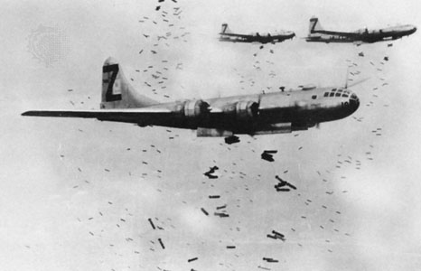
THOR Introduction
Theater History of Operations (THOR) is a collection of data regarding aerial bombings through several wars in the 20th century.
WWII data was selected in order to analyze bombings from the deadliest conflict in human history.

Slide 3
Data Extraction
The main dataset was extracted from data.world
This dataset consists of a main .csv file containing information about all the recorded missions (bombings) such as location, type of bomb, number of aircraft, date, etc.
Two complimentary files provide additional details about aircraft and weapon types described in the main file.
An additional dataset from Kaggle was included in the data extraction process. This time, the data provides details regarding weather conditions during WWII.
When both datasets are combined, it is possible to analyze how weather conditions might have affected the result of an aerial bombing.

Slide 4
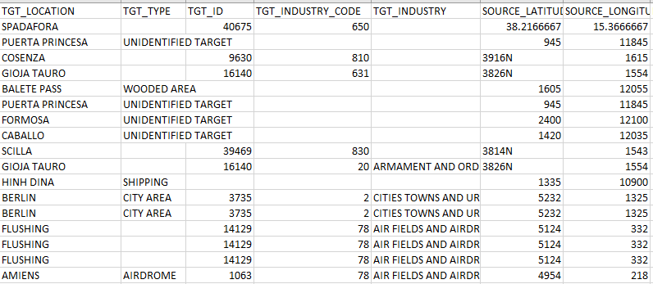
Data Snippet

Slide 5
Data Transformation
Since the data was recorded manually in the 1940's by many different military groups, a large portion of the information is missing.
At the same time, there are multiple categories that provide little to no information or are reduntant, and therefore don't need to be included in the database.

Slide 6
Schema

Slide 7
Data Loading

